Slide 1
INF10025
Data Management and Analytics
Lecture 9 – Part 4
Emerging Uses of Databases

Slide 2



Blockchain
  Blockchain is a secure and decentralized digital ledger technology that records and manages transactions in a continuously growing list of records called blocks.
  Databases are important in blockchain technology because they provide a secure and reliable way to store and manage transaction data in a decentralized and tamper-proof manner. They also facilitate the execution and management of smart contracts, which are essential to the functioning of blockchain networks.
  NoSQL Database Management Systems use mostly due to the increased speed of access.

Slide 3
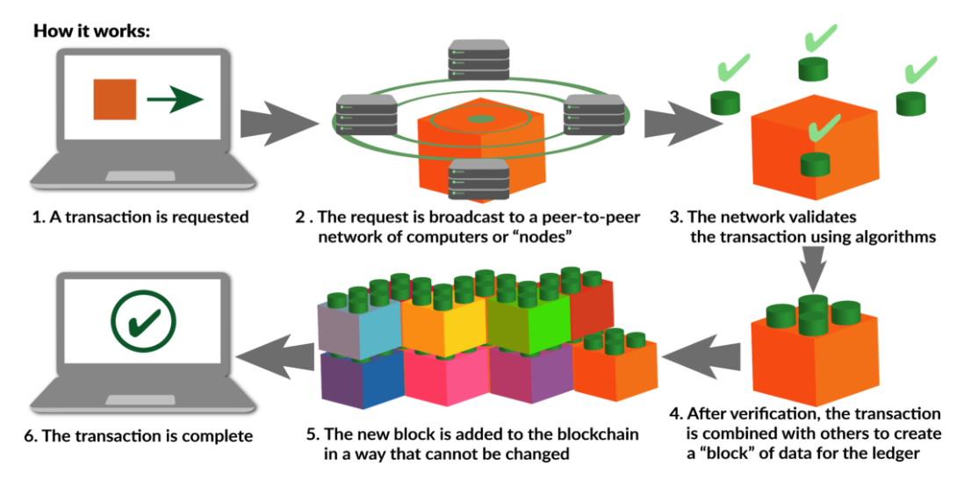
How it works
https://www.gisreportsonline.com/r/blockchain-decentralized-ledger-transactions/

Slide 4
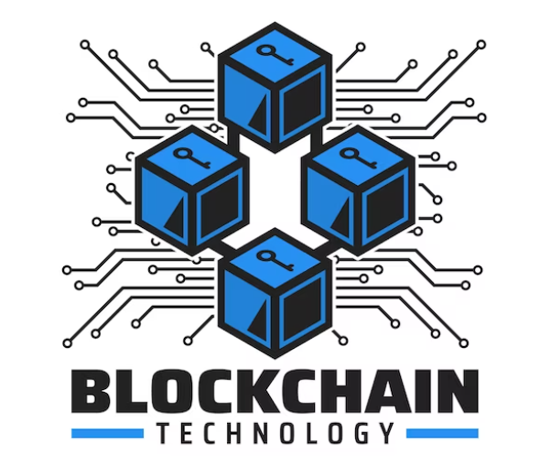
Uses for Blockchain
Cryptocurrencies
Supply chain management
Digital identity verification
Smart contracts
Voting systems
Real estate
Health care
Blockchain Technology is ideal for anything that requires high data security.

Slide 5
Blockchain - Challenges and Limitations
Scalability
  Large storage requirements. As the number of transactions increase the Chain grows, requiring more storage
Data Redundancy.
  Full data replication on each Node.
Consistency
  Ensuring that the data on all Nodes is correct and up to date.
Hard to Query
Integration with existing systems
  Legacy Systems are usually designed to work with Relational Databases.

Slide 6

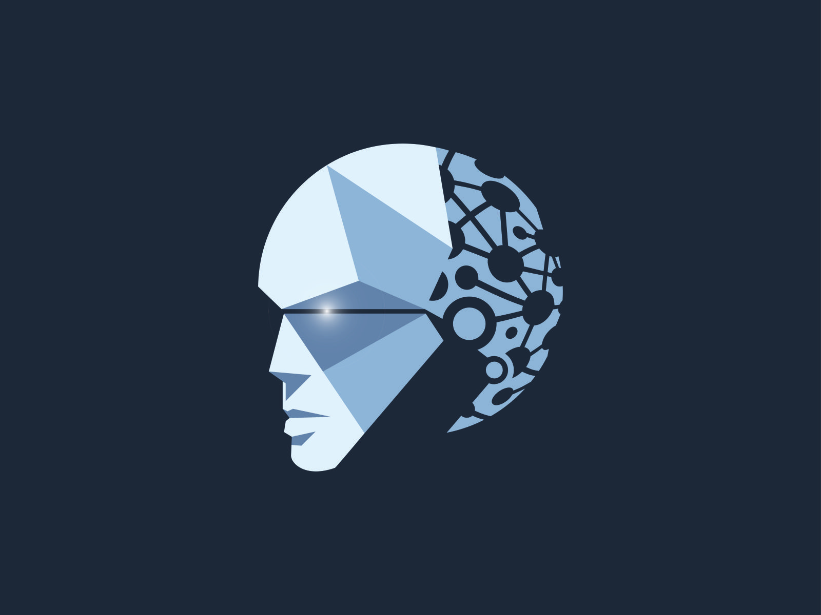
Artificial Intelligence
Artificial Intelligence (AI) is a technology that allows machines and computer applications to mimic human intelligence, learning from experience via iterative processing and algorithmic training.
AI works by combining large amounts of data with fast, iterative processing and intelligent algorithms.
The software learns automatically from patterns or features in the data that they analyze.
AI software can analyze huge volumes of data in a very short time.

Slide 7
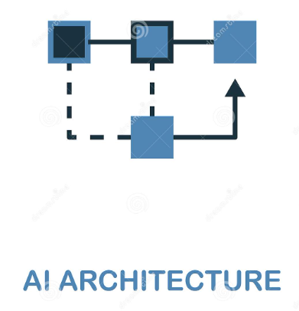
Artificial Intelligence Architecture
AI is not just a single software package, but a whole series of techniques and processes, as well as a vast array of different technologies.
Processes include Machine Learning, Deep Learning, Neural Networks, Cognitive Computing, Natural Language Processing, and Computer Vision.
All of this is data driven, hence the Database/s is essential to all AI.
AI Systems generally uses Relational Database Management Systems, but other types of DBMS are also used.

Slide 8
Artificual Intelligence Uses
Chatbots
  ChatGPT
  Online 24/5 customer support
Agriculture
  Weather analysis, Pest control, Crop analysis
eCommerce
  Trend prediction
  Track usage patterns
    Credit card fraud detection
  Recommendation engines (Advertising)
Education
  Grading Assessments
  Teaching material enhancement
Finance
  Fraud Detection
  Risk Management
  Automated Trading
Healthcare
  Automated surgery
  Medical diagnoses
  Drug development
Marketing
  Personalized messaging
  Report generation
  Campaign retargeting
Social Media
  Behaviour tracking
  Targeted content
  Trend identification
In-home applications
  Facial recognition
  Robotic vacuums and lawnmowers
  Email spam filtering
  Siri, Cortana, Google Assistance

Slide 9
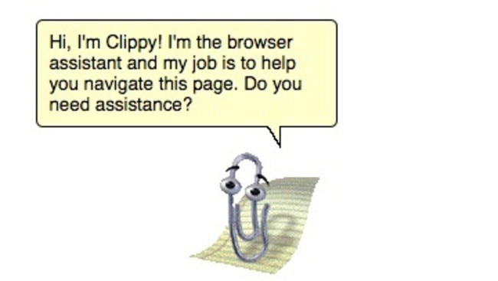
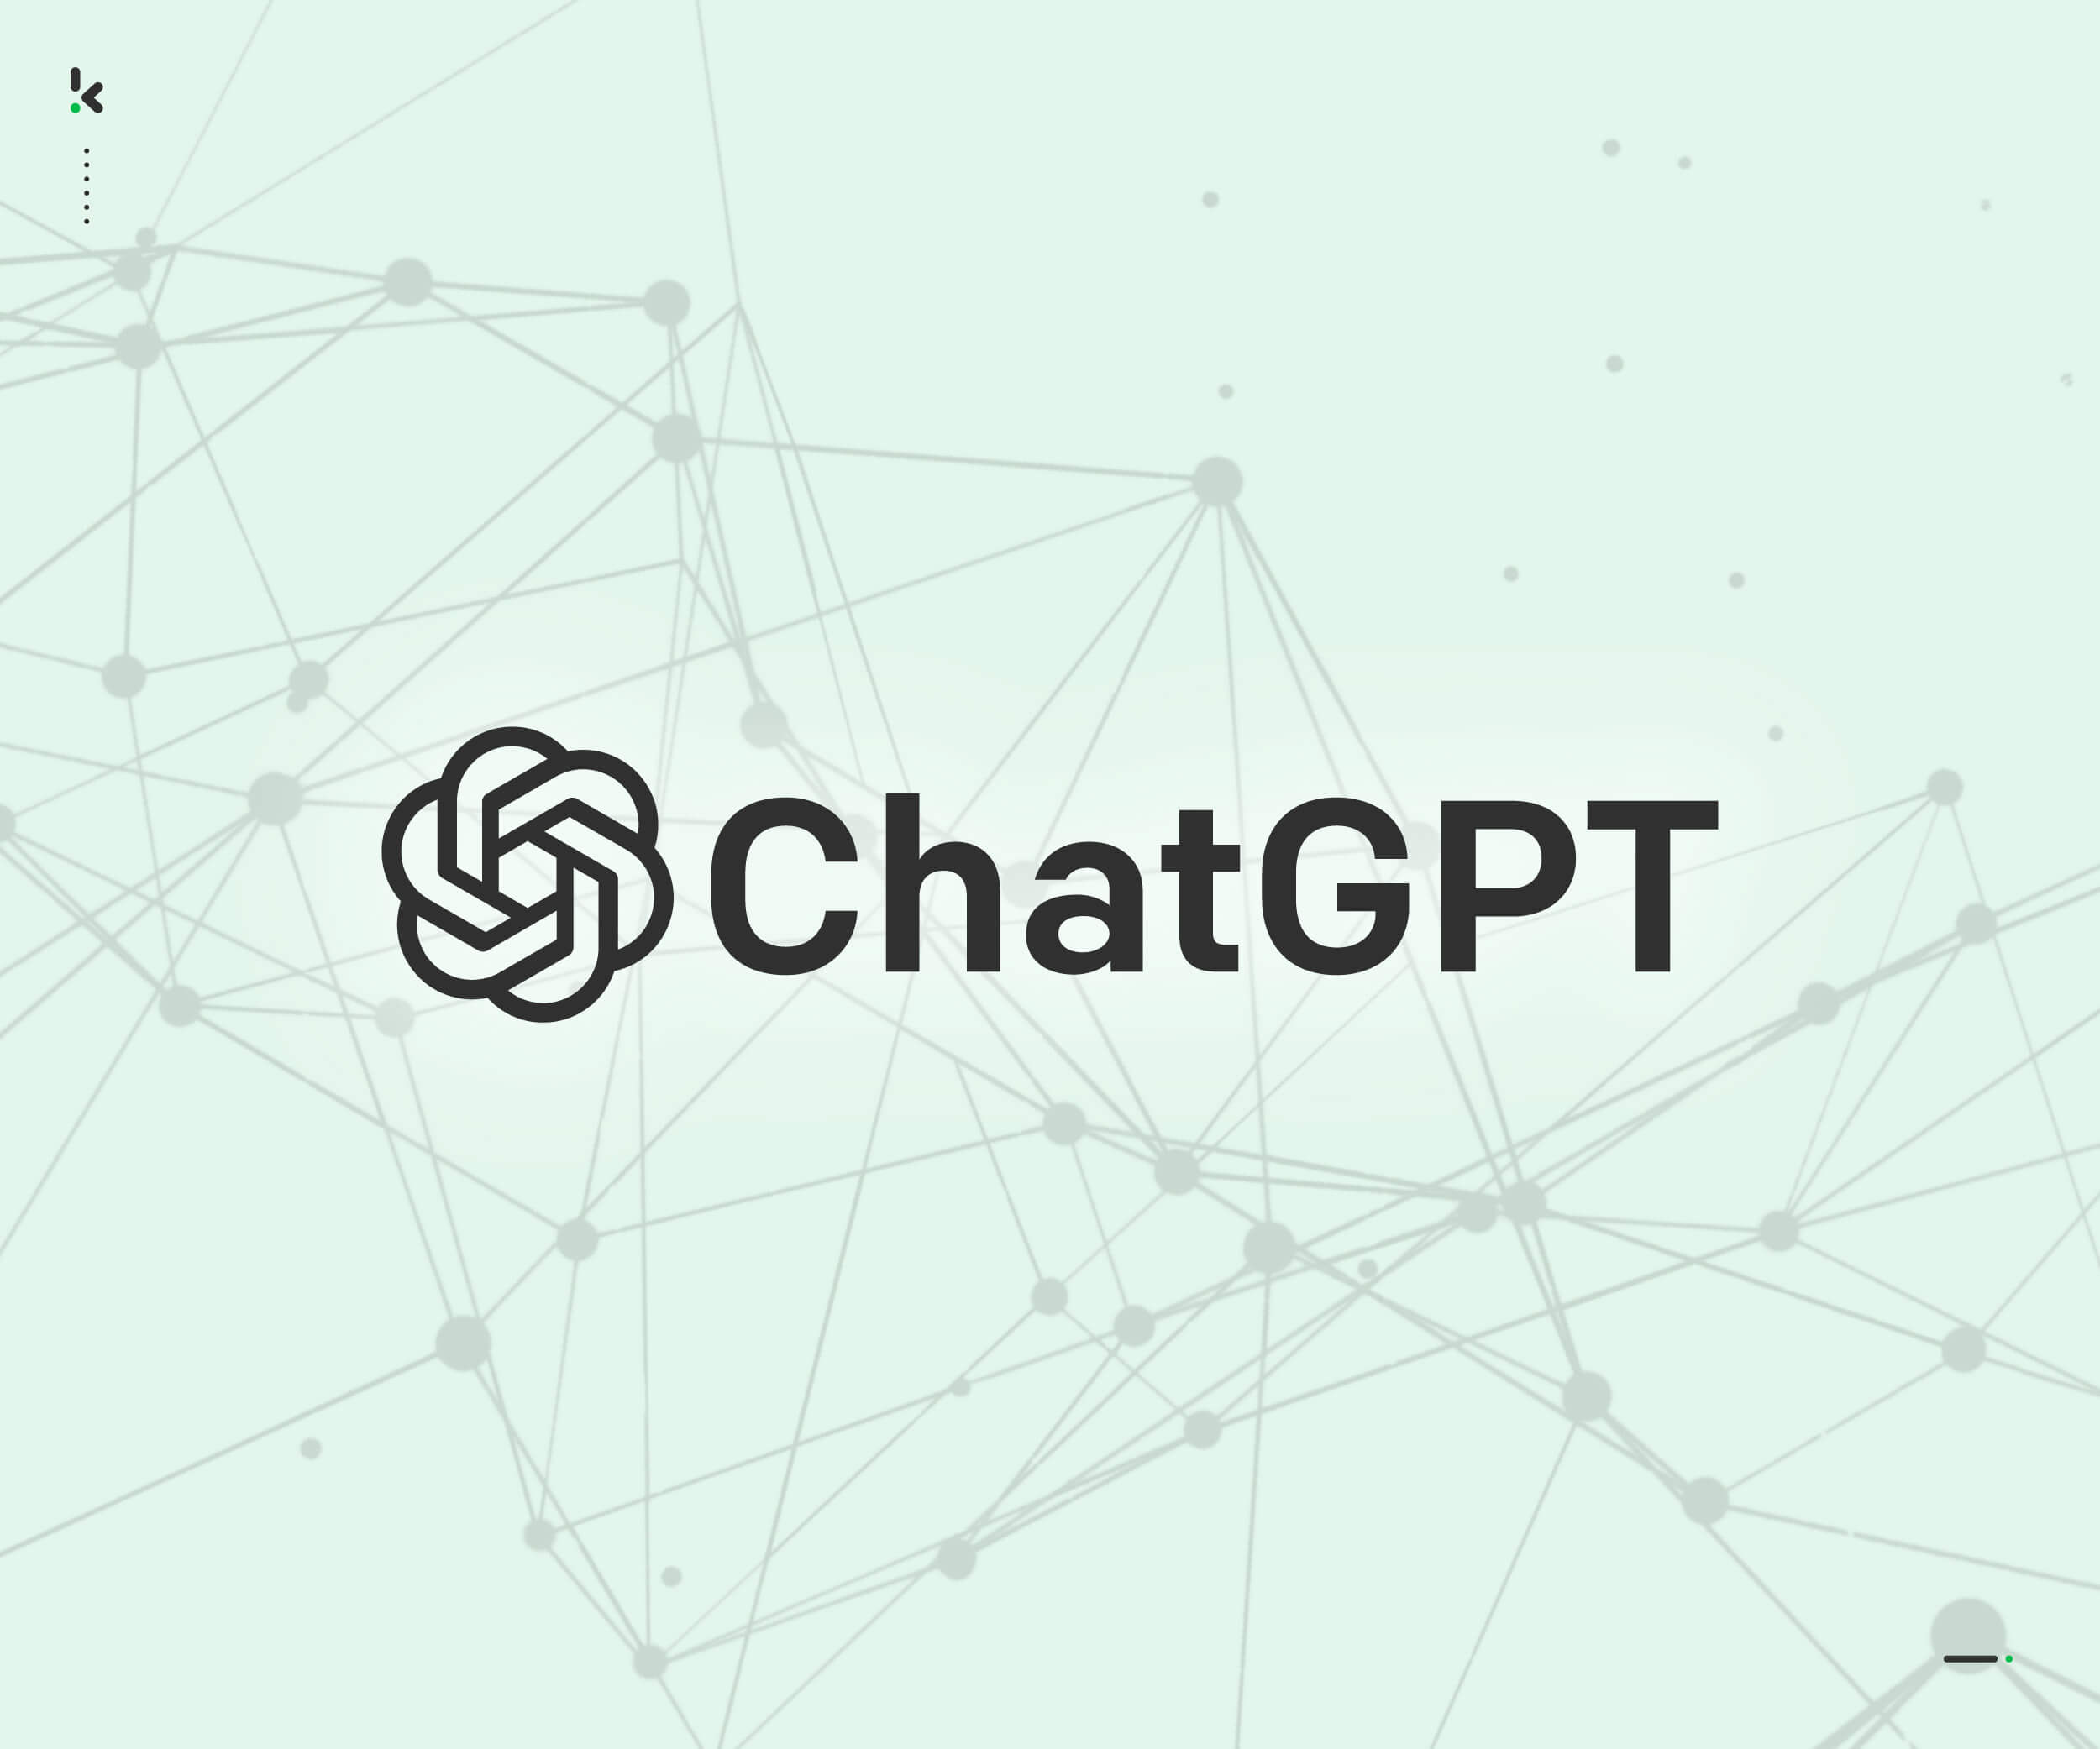
Chatbots
Chatbots are computer programs designed to simulate conversation with human users through messaging or voice interfaces.
They work by using natural language processing (NLP) and machine learning algorithms to understand user inputs and respond with relevant information or actions.
The chatbot's conversational flow is managed by a set of rules and algorithms that determine the sequence of messages exchanged between the chatbot and the user.
Chatbots can be integrated into websites, mobile apps, social media platforms, and messaging apps to provide instant customer support and automate various tasks.
Chatbots use databases to store and manage data required for the chatbot to function properly, such as user data, conversational flows, and information required to answer user queries.
Chatbots provide benefits such as 24/7 availability, scalability, cost savings, and personalization.
The future of chatbots is driven by advancements in AI technologies, voice-enabled chatbots, integration with IoT, and augmented reality.

Slide 10



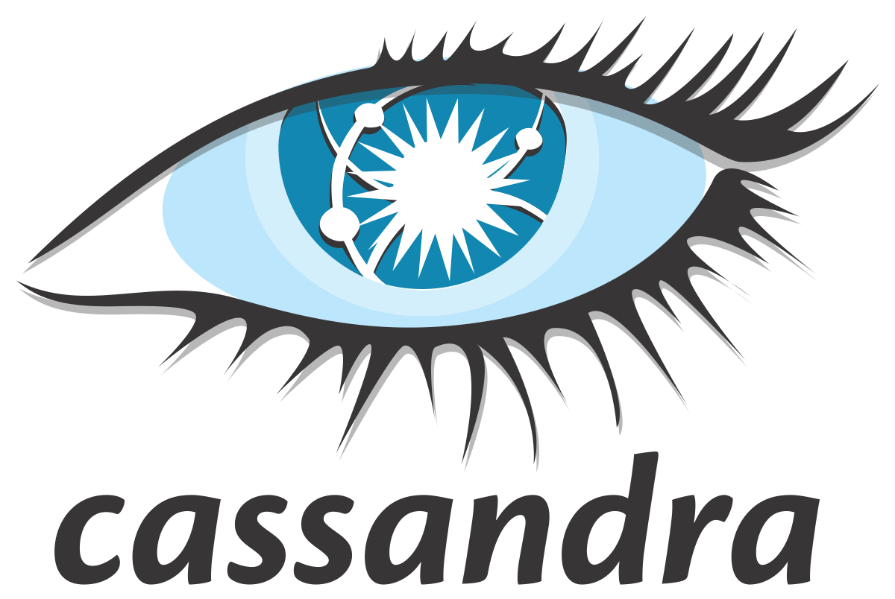




Databases used with AI / Chatbots
Databases play a critical role in the development of AI and chatbots, as they store and manage the data required for training and inference of machine learning models. Here are some of the databases used with AI and chatbots:
Big Data Databases: Big data databases, such as Apache Hadoop and Apache Spark, are used for storing and processing large volumes of data required for training machine learning models. These databases enable parallel processing of data across distributed clusters, making it possible to handle massive amounts of data.
Relational Databases: Relational databases, such as MySQL, PostgreSQL, and Oracle, are used for storing structured data, such as user profiles, chat histories, and preferences, required for chatbots to function properly. These databases allow for complex queries and joins, making it possible to retrieve and manipulate data efficiently.
NoSQL Databases: NoSQL databases, such as MongoDB and Cassandra, are used for storing unstructured and semi-structured data required for chatbots to handle flexible and scalable data storage. These databases are also used for storing data generated by IoT devices and sensors, which can be used to train machine learning models for chatbots.
Graph Databases: Graph databases, such as Neo4j and Amazon Neptune, are used for storing and managing relationships between data points required for chatbots to handle complex relationship management. These databases are also used for social network analysis and recommendation systems.
Memory Databases: Memory databases are designed to store data in memory rather than on disk, allowing for very fast data access and retrieval. Memory databases such as Redis and Memcached are often used with chatbots that require fast response times and low latency.

